Slide 1
Citi Bike Data Analysis
By [Nadia Islam Joya]

Slide 2
Project Goal:
To better understand the behavior of Citi Bike’s customer base (both one-time users and subscribers) and how they use Citi Bikes
This will help us to:
Identify where more bikes should be installed
Create targeted marketing campaigns that will appeal to different customer segments

Slide 3
Key questions:
What are the most popular pick-up locations across the city for Citi Bike rental?
How does the average trip duration vary across different age groups?
Which age group rents the most bikes?
How does bike rental vary across the two user groups (one-time users vs long-term subscribers) on different days of the week?
Does the factor of user age impact the average bike trip duration?

Slide 4
Findings & Insights

Slide 5
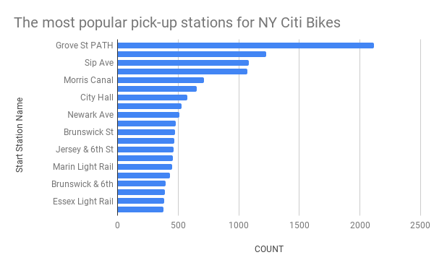
What are the most popular Citi Bike pick-up locations?

Slide 6
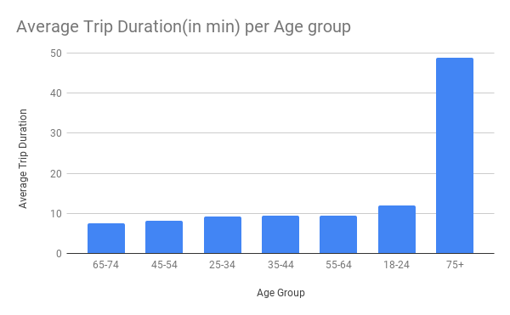
2. How does the average trip duration vary across different age groups?
Average trip duration is highest among 75+ age group.
Whereas it is lowest among 65-74 age group followed by 45-54 age group.

Slide 7
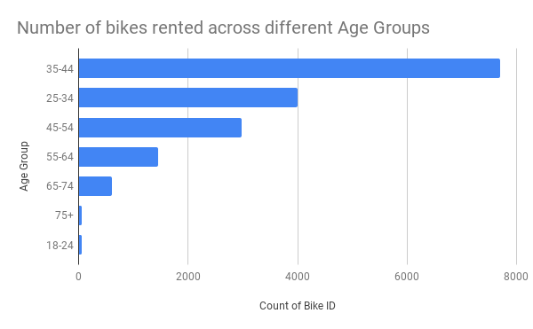
3. Which age group rents the most bikes?
People aged from 35-44 rents most bikes.
18-24 years old age people rent the least bikes nearly followed by people aging 75+ year old..

Slide 8
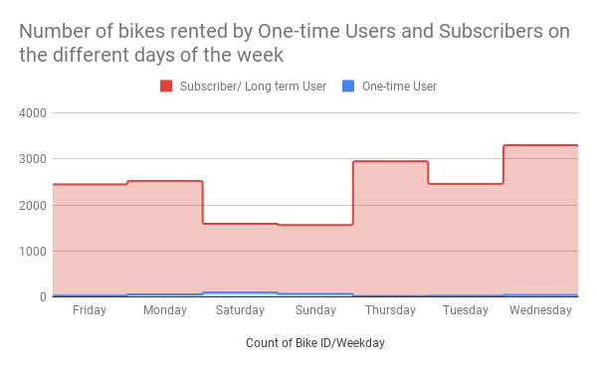
4. How does bike rental vary across the two user groups (one-time users vs long-term subscribers) on different days of the week?
One-time users mostly uses the bike on weekends.
Subscribers/long-term users rent the bike mostly on weekdays.

Slide 9
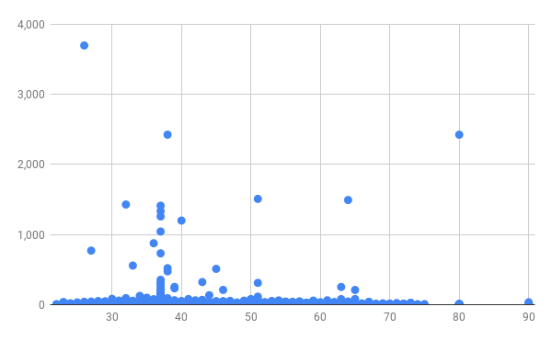
5. Do factors like weather and age impact the average bike trip duration?
Here, factors like weather and age do not impact the average bike trip duration.

Slide 10
Summary

Slide 11
Summary of findings:
Top 5 pick-up locations for bikes:
Grove St Path, Exchange Place, Sip Ave, Hamilton Park, & Morris Canal
Customer base:
Based on your findings, how would you describe Citi Bike’s customer base? Think in terms of characteristics like age and user type
Citi Bike customer behavior:
Who takes the longest and shortest trips on average?

Slide 12
Actions & Recommendations

Slide 13
Recommended actions:
Product recommendations:
Install more bikes at ...
Marketing recommendations:
The Citibike customer base is mostly Long-term subscribers aged between 35-44, who are most active weekdays. This tells us that they are probably people who live in New York and use Citi Bikes to commute. Marketing and advertising campaigns should therefore target this particular demographic.

Slide 14
Thank you!

